Slide 1
Stack
A variable sized data structure in which insertion or deletion is made just from one end
or
A LIFO data structure is called Stack
Operations on Stack
Push ( to insert an element into stack)
2) Pop( to take an element out of stack)
The last element inserted is deleted or taken out first and first element at last
The stack can be implemented using Array as well as Link List

Slide 2
Stack using Arrays
The no of elements that can be inserted in a stack is the dimension of array. The current position of stack(i.e its size is known by a pointer called its top.
Algorithm to insert data in stack Push(S,Top, X, N)
1 If Top >= N then
write (‘Stack full’) and exit
2 Top=Top+1
3 S[Top]= X
4 Exit

Slide 3
Stack Operations
Algorithm to delete an element from Stack Pop(S, Top)
If Top= 0 then
write(‘ stack is empty’) and exit
Pop = S[Top]
Top= Top-1
Exit
Applications of Stack
Recursion
Evaluation of Arithmetic expressions
a) Infix notation
b) prefix notations
c) postfix notations

Slide 4
Recursion
The calling of a subprogram to itself is called recursions
Examples: Factorial of a number
Fact(N)
If N= 0 then
Fact =1
Fact= N* Fact(N-1)
Polish Suffix notations
It is named after Polish mathematician Jan Lukasiewiez. The operator symbol is placed before its two operands in this notations
Examples: +XY, AB+, CD-, EF*

Slide 5
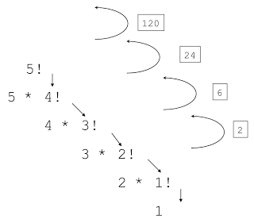
Application of Stack
Fact(int f) {
if (f == 1) return 1; return (f * Fact(f - 1)); } int main() { int fact; fact = Fact(4); printf("Factorial is %d", fact); return 0; }

Slide 6
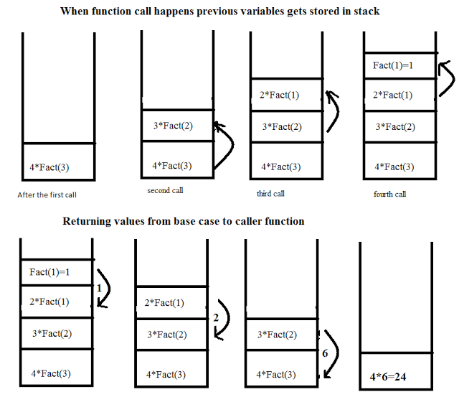
Application of Stack

Slide 7
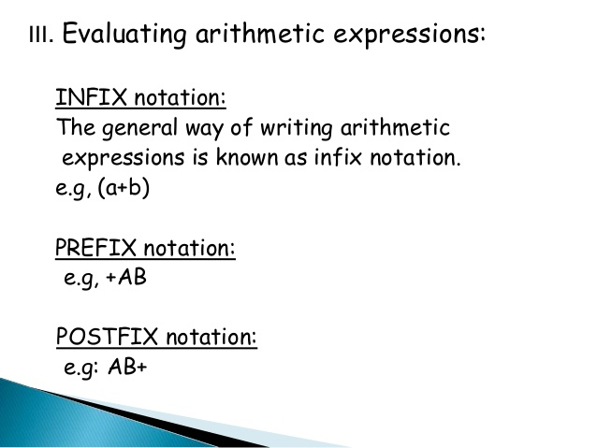
PSN notations

Slide 8
PSN notations Polish Suffix Notation
Infix | Postfix
A + B 12 + 60 – 23 (A + B)*(C – D ) A * (B + C / D) A * (B + C) / D | A B + 12 60 + 23 – A B + C D – * A B C D / + * A B C + * D /

Slide 9
PSN notations
The expressions in which operands are preceded by the operators are called PSN notations or postfix notations.
Example: Following are PSN notations
AB+
DE*
ABC*+
Convert A+B*C into PSN
Symbol scanned operator Stack PSN
A A
+ + A
B + AB
* +* AB
C +* ABC
$ ABC *+

Slide 10
RPN(Q, P)
Suppose Q is expression in infix form. This pseudocode covert this expression into equivalent postfix expression P
Scan Q from left to right and repeat Steps 2 to 5 for each element of Q until the end of Expression
If an operand is encountered, add it to P
If a left parenthesis is encountered, push it onto stack
If an operator is encountered then:
a) Repeatedly pop from stack and add to P each operator which has the same precedence as or higher precedence than (?)
b) Add (?) to stack
If a right parenthesis is encountered then:
a) Repeatedly pop from stack and add to P each operator until a left parenthesis is encountered
b) remove left parenthesis
6) Exit

Slide 11
Algorithm for Infix to postfix Conversion
Stack s; //declare s stack
While(not end of input){
c= next input character
if (c is an operand)
add c to postfix string;
else{
while(!s.empty() && prcd(s.top(),c)) {
op= s.pop();
add op to the postfix string;
} s.push(c); } //end of else
} end of while

Slide 12
Algorithm for Infix to postfix Conversion
While (!s.empty()) {
op=s.pop();
add op to postfix string;
}
//prcd(op1,op2)
Where op1 and op2 are two operators
It returns true if op1 has precedence over op2
e.g. prcd(*,+) will return true

Slide 13
PSN Exercise
A + (B + C * D ^2 + 3)
((A+B) * C –(D-E)) *(F+G)
A – B / (C* D^E)
Assignments
Write an algorithm that should evaluate a postfix expression
Write a program to convert
a) A prefix expression to postfix
b) A postfix expression to prefix
c) A prefix expression to infix
d) A postfix expression to infix

Slide 14
Pseudocode for evaluation of PSN
1 Scan the Postfix string from left to right.
2 Initialize an empty stack.
Repeat step 4 until the end of string
If the scanned character is an operand, Push it to the stack.
Else
a) If the scanned character is an Operator, pop top two elements and apply operator.
b) Push result back on top of stack
5 Pop last value from stack
5 Exit.

Slide 15
Algorithm for evaluation of PSN
Stack s; //declare s stack
While(not end of input){
e=get next element of input
if (e is an operand)
s.push(e);
else{
op2=s.pop();
op1=s.pop();
value=result of op1 and op2 by applying operator e
s.push(value); }
} finalresult=s.pop();

Slide 16
Example
infix expression: 1+ 2 *3
Postfix : 1 2 3 * +
Symbol Stack
1 1
2 1, 2
3 1, 2, 3
* 1, 6
+ 7

Slide 17
Example Infix: A+(B*C)/D Postfix:ABC*D/+ with A=2, B=3, C=4 and D=6
Read Symbol Stack
A 2 PUSH(A=2)
B 2 3 PUSH(B=3)
C 2 3 4 PUSH(C=4)
* 2 12 POP(4),POP(3),PUSH(R)
D 2 12 6 PUSH(D=6)
/ 2 2 POP(6),POP(12),PUSH(R)
+ 4 POP(2),POP(2),PUSH(R)

Slide 18
Evaluation of PSN
Evaluate the following postfix expression using stack.
6 2 3 + - 3 8 2 / + * 2 - 3 +

